Slide 1
RFC 9114 – HTTP/3
Understand the QUIC transport protocol

Slide 2
Introduction – HTTP/3 and QUIC
HTTP/3 is the latest version of the HTTP protocol, designed to improve web communication performance. Unlike its predecessors, HTTP/3 relies on QUIC (Quick UDP Internet Connections), a transport protocol based on UDP, and integrates TLS 1.3 to ensure a secure connection.
Transition from HTTP/2 to HTTP/3: HTTP/3 enhances stream management and eliminates head-of-line blocking issues that affected HTTP/2.
QUIC: QUIC, used by HTTP/3, enables faster connections by reducing initial connection delays and managing network congestion more effectively.
HTTP/3 represents a significant advancement in optimizing web browsing, offering faster and more secure communications.

Slide 3
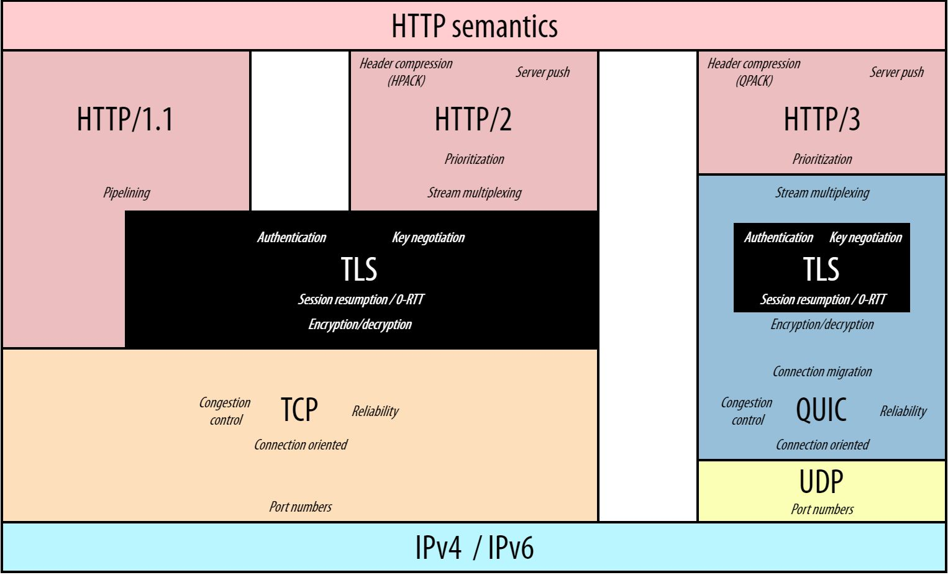

Slide 4
Performance Improvements with HTTP/3
HTTP/3 offers several performance improvements over HTTP/2, primarily due to the use of QUIC and its stream management:
Elimination of Head-of-Line Blocking: Unlike HTTP/2, which suffers from blocking when packets are lost or delayed, HTTP/3 allows data to be sent independently across different QUIC streams, eliminating this issue.
Multiplexing and QUIC Stream Management: HTTP/3 enables multiple requests and responses to be sent simultaneously on the same connection without interfering with each other. Each stream is handled independently, optimizing network usage and reducing latency.
Faster Connection Setup: With QUIC, connections are established more quickly, reducing the waiting time for communication setup and enhancing the user experience.
These improvements make HTTP/3 faster, more reliable, and more efficient, especially in complex network environments.

Slide 5
Header Compression and Management: HPACK to QPACK
HTTP/3 introduces a new approach to header compression and management, optimized for the QUIC protocol:
HPACK to QPACK: HTTP/2 used HPACK for header compression, but HTTP/3 adopts QPACK, an enhanced version designed to manage header compression efficiently without suffering from head-of-line blocking issues. QPACK is tailored to work in the context of QUIC's independent streams, allowing better handling of compressed headers.
Header Compression: QPACK reduces the size of headers, decreasing the amount of data exchanged and improving network performance. This allows more efficient use of bandwidth and reduces latency in communication.
These improvements enhance the protocol’s efficiency by optimizing header management while maintaining performance and reliability.

Slide 6
Security and TLS 1.3 in HTTP/3
HTTP/3 integrates TLS 1.3 to ensure secure connections from the start of the data exchange:
Integration of TLS 1.3 with QUIC: Unlike HTTP/2, which requires a separate layer for TLS, HTTP/3 uses TLS 1.3 directly within the QUIC protocol, reducing complexity and improving secure connection performance. This integration enables faster negotiations and enhanced security due to reduced handshake delays.
Authentication and Encryption: HTTP/3 relies on a valid TLS certificate for each connection, ensuring that exchanges are protected and the server’s identity is verified. The use of QUIC and TLS 1.3 also safeguards against "downgrade" attacks and other vulnerabilities.
ALPN (Application-Layer Protocol Negotiation): ALPN enables HTTP/3 to automatically negotiate the protocol used during the TLS handshake, ensuring that both the client and server use the same secure protocol (such as HTTP/3).
These security mechanisms make HTTP/3 a reliable choice for modern and secure web communications.

Slide 7
Connection and Error Management in HTTP/3
Connection and error management in HTTP/3 relies on strict rules to ensure smooth and reliable communication:
Connection Closure: HTTP/3 allows precise management of connection closures. Connections can be closed gracefully (with an explicit closure signal), abruptly (in case of error or network issues), or due to timeout (automatically closing idle connections). These mechanisms ensure optimal resource management.
Error Handling: HTTP/3 uses specific error codes to identify and manage issues related to streams or the connection. For example, H3_FRAME_ERROR signals errors with malformed frames, while H3_REQUEST_CANCELLED indicates a canceled request. These codes allow precise handling and quick resolution of issues.
Flow Control and Connection Persistence: HTTP/3 allows connections to remain open and reusable for multiple requests, reducing the need to establish new connections for each exchange. Connections can be reused as long as they are not closed by either party or an error does not occur.
These features ensure that HTTP/3 exchanges are optimized and reliable, even in the event of technical issues.

Slide 8
Structure of a Frame Packet in HTTP/3
Frames in HTTP/3 are data units sent over QUIC streams and are essential for communication between the client and server. Each frame has a specific structure, consisting of three main parts:
Frame Type: Identifies the purpose of the frame (e.g., DATA, HEADERS, SETTINGS, etc.).
Length: Specifies the size of the frame's payload (the actual data).
Frame Payload: Contains the data specific to the frame type (e.g., content data in a DATA frame, compressed headers in a HEADERS frame).
Frames must follow strict rules:
Some frames can only appear in specific streams (e.g., DATA and HEADERS in request and response streams).
Any violation of frame rules results in a connection error (H3_FRAME_ERROR).
Frame types include:
DATA: Carries content data of the request or response.
HEADERS: Contains HTTP headers compressed via QPACK.
SETTINGS: Contains configuration parameters for the connection.
GOAWAY: Signals the closure of a connection.

Slide 9
